Slide 1
Doing Your Own Taxes/ Compound Interest
College Prep
Mr. Gordon
jgordon@bisdtx.org

Slide 2
Upcoming Events
hi

Slide 3
Doing Your Own Taxes
Wages and Salaries
Wages, salaries, bonuses, and commissions are compensation received by employees for services performed.
Tips
Tips are received as gratuities by food servers, baggage handlers, hairdressers, and others for services performed. Tips go beyond the stated amount of the bill and are given voluntarily.
Employee compensation and tips may be in the form of cash, goods and services, awards, and taxable benefits.
hi

Slide 4
Doing Your Own Taxes
Self-Employment
Self-employed individuals are not employees. Self-employment income is taxable, but it is not included with wage and tip income on the tax return.
hi

Slide 5
Doing Your Own Taxes
Employers withhold taxes from employees' pay.
Gross pay is the amount the employee earns.
Net pay, or take-home pay, is the amount the employee receives after deductions.
The difference between gross pay and net pay is:
Social Security taxes
Medicare taxes
income tax withheld
other amounts withheld
Employers send the withheld taxes to the federal government.
hi

Slide 6
Doing Your Own Taxes
Tax Day
Usually taxes must be completed by April 15th unless you ask for an individual extension or Congress passes an extension.
Form W-4
Employees complete Form W-4, Employee's Withholding Allowance Certificate to determine how much federal income tax to withhold.
Employers use Form W-4 to determine how much income tax to withhold from employee pay
hi

Slide 7
Doing Your Own Taxes
Employers withhold payroll taxes and income tax from employees' pay.
Employers send the amounts withheld to the federal government.
You get a W2 form in the mail in January to assist with your taxes
Tax Withholding Estimator
https://apps.irs.gov/app/tax-withholding-estimator
hi

Slide 8
Doing Your Own Taxes
Form W-4
The amount of federal income tax withholding depends on:
the employee's marital status
the number of withholding allowances claimed by the employee
any additional amount the employee wants to withhold, and
any exemptions from withholding that the employee claims.
You will complete this form when you are first hired.
hi

Slide 9
Doing Your Own Taxes
Review Form W-4 for Angela V. Notice that Angela is single and claims one withholding allowance.
Angela Viviano earns $2,000 a month as a physical therapist's assistant. In addition to payroll taxes and income tax withholding, her employer withholds $50 for her retirement account. Angela's net pay is calculated as follows:
Angela earns $2,000 gross pay and receives a net paycheck for $1,560.
Her employer sends $390 ($124 + $29 + $237) to the federal government and $50 to the retirement fund.
hi

Slide 10
Doing Your Own Taxes
Gross pay
$2,000.00
Social Security tax (6.2 percent of gross pay)
-$124.00
Medicare tax (1.45 percent of gross pay)
-$29.00
Income tax (per Form W-4)
-$237.00
Retirement
-$50.00
Net pay
$1,560.00
hi

Slide 11
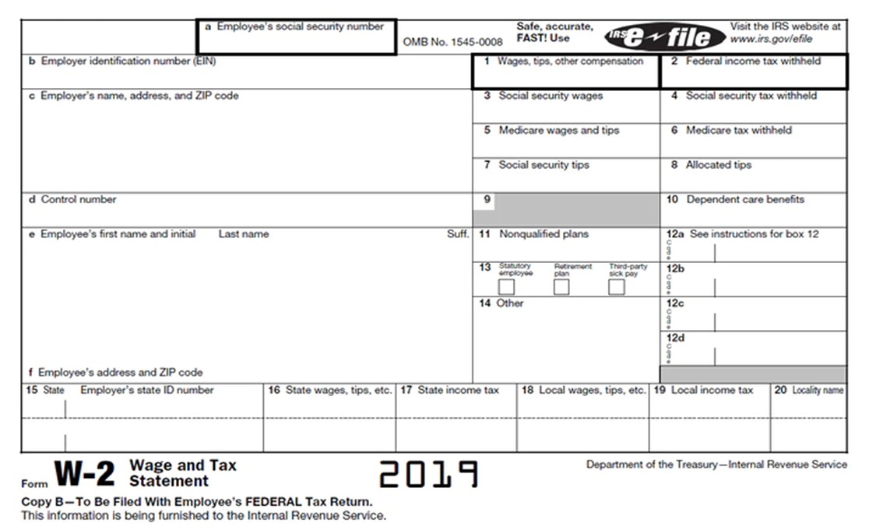
Doing Your Own Taxes
hi

Slide 12
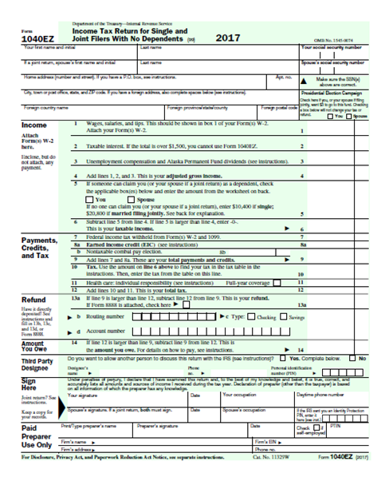
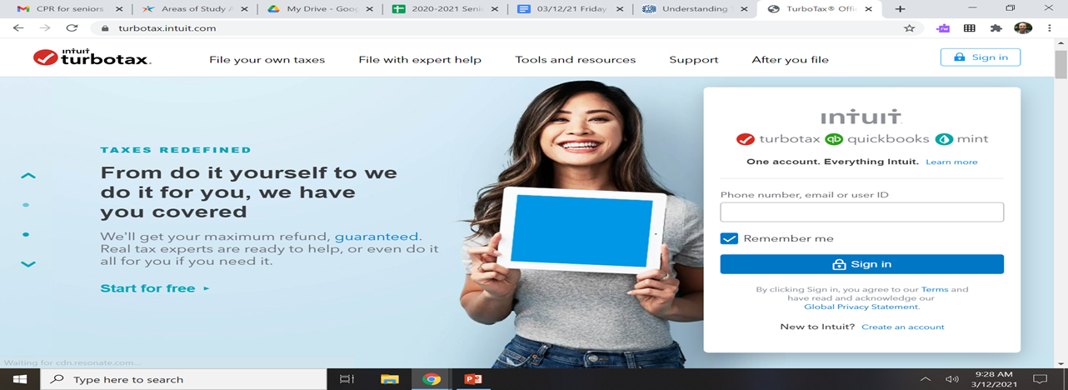
Doing Your Own Taxes
You will use IRS 1040 EZ form to file your taxes until you have multiple dependents, multiple jobs, own your own business, etc.
Most people I know use Turbo Tax.
hi

Slide 13
Compound Interest
“Compound interest is when you earn interest on both the money you've saved and the interest you earn”
Or
“Compound interest simply means that the interest associated with a bank account, loan, or investment increases exponentially—rather than linearly—over time.” Investopedia
hi

Slide 14
Compound Interest
Compound Interest Calculator
Many financial advisors use 7% as an estimated interest rate growth.
https://www.investor.gov/financial-tools-calculators/calculators/compound-interest-calculator
hi

